Slide 1
Quara Holding
Coverage Highlights
2020 - 2021
December 2021

Slide 2
2020 Coverage Highlights
2021 Coverage Highlights
Contents

Slide 3
2020
Coverage Highlights

Slide 4
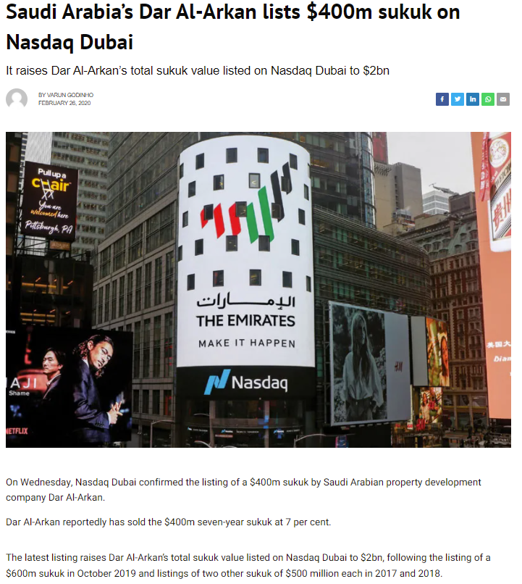
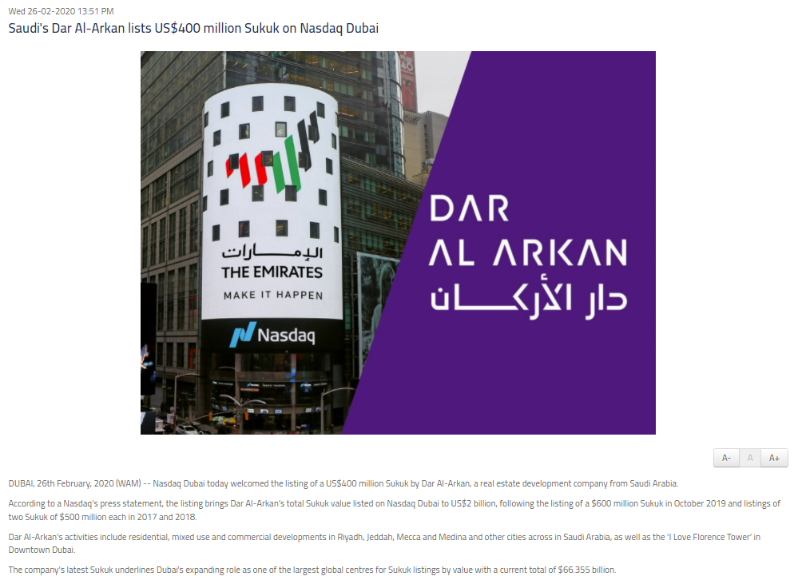
Feb 2020: Saudi Arabia’s Dar Al Arkan lists $400m sukuk on Nasdaq Dubai
Gulf Business
WAM

Slide 5
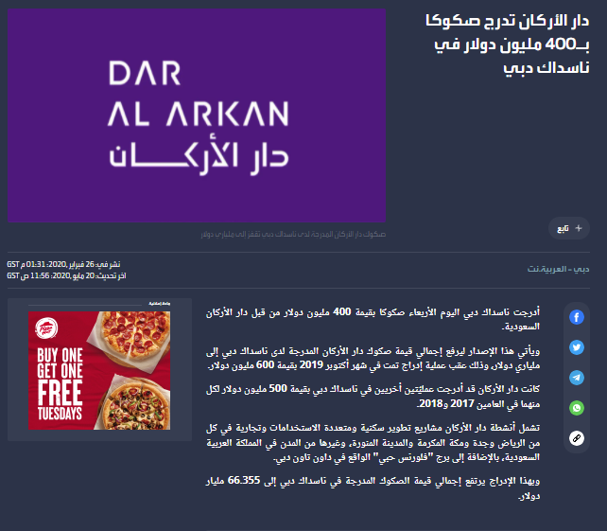
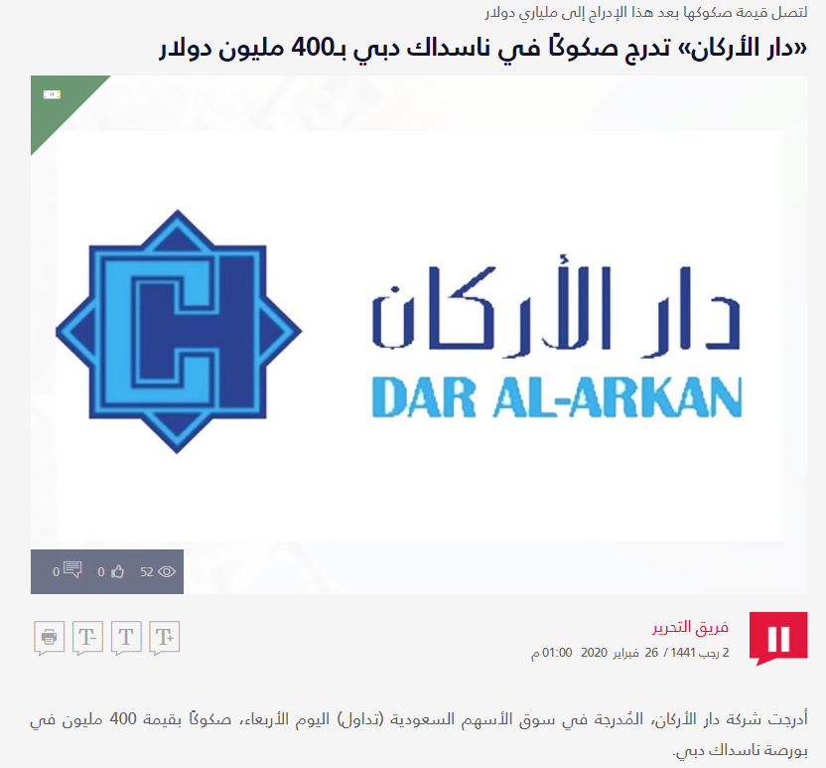
Feb 2020: Saudi Arabia’s Dar Al Arkan lists $400m sukuk on Nasdaq Dubai
Al Arabiya
Ajel

Slide 6
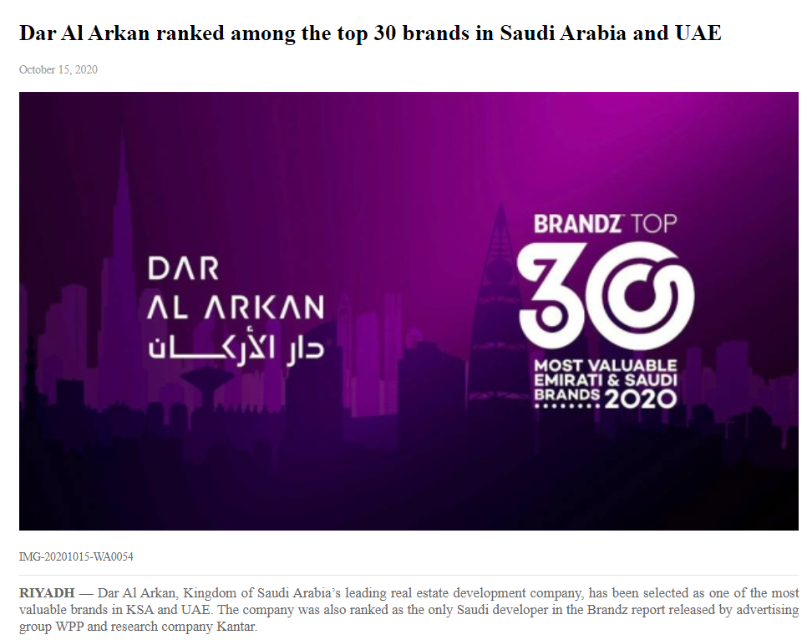
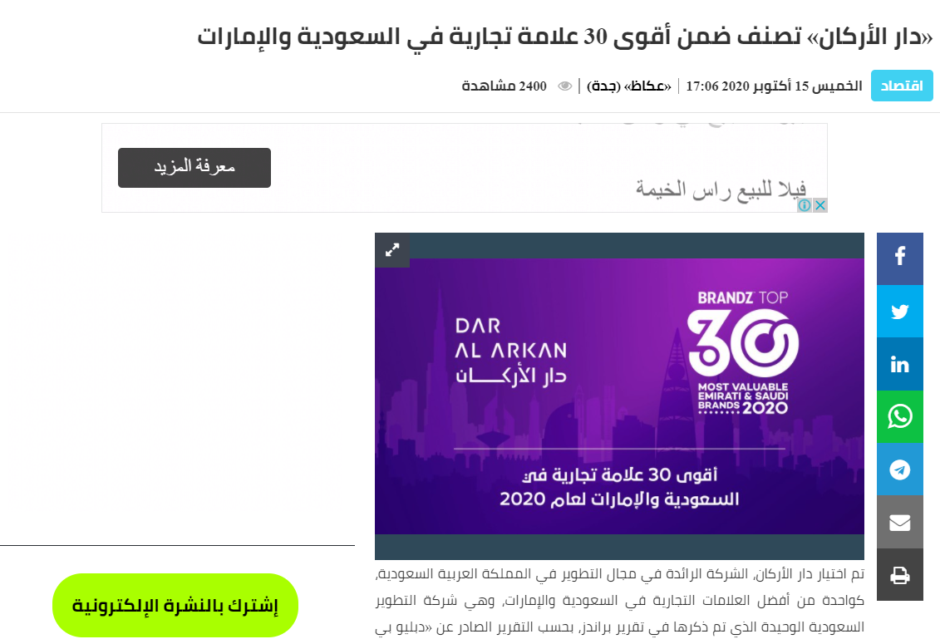
Oct 2020: Dar Al Arkan ranks among the top 30 most powerful brands in Saudi Arabia and the UAE
Saudi Gazette
Okaz

Slide 7
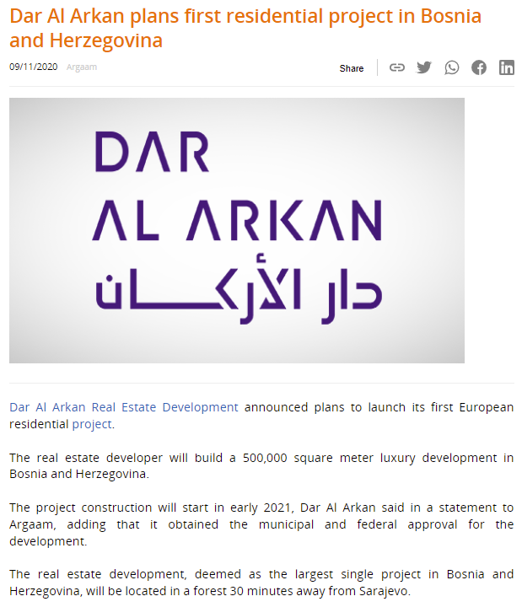
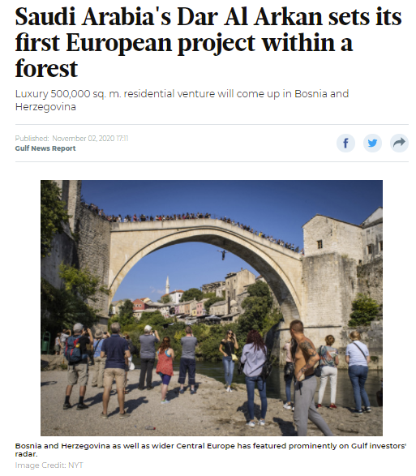
Nov 2020: Dar Al Arkan plans first residential project in Bosnia and Herzegovina
Argaam
Gulf News

Slide 8
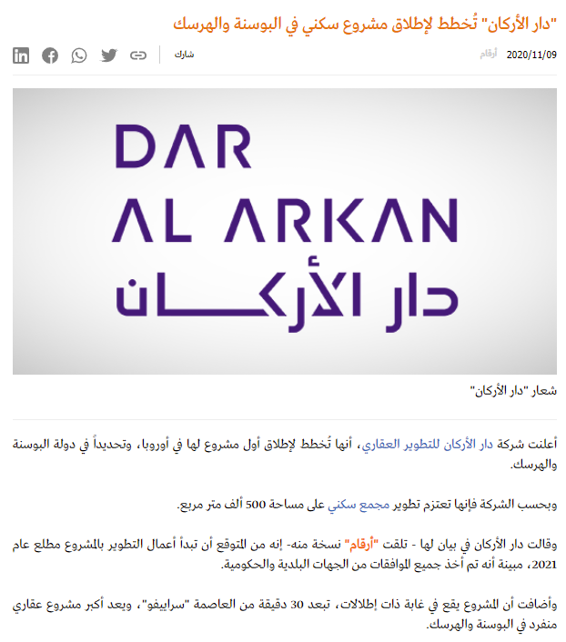
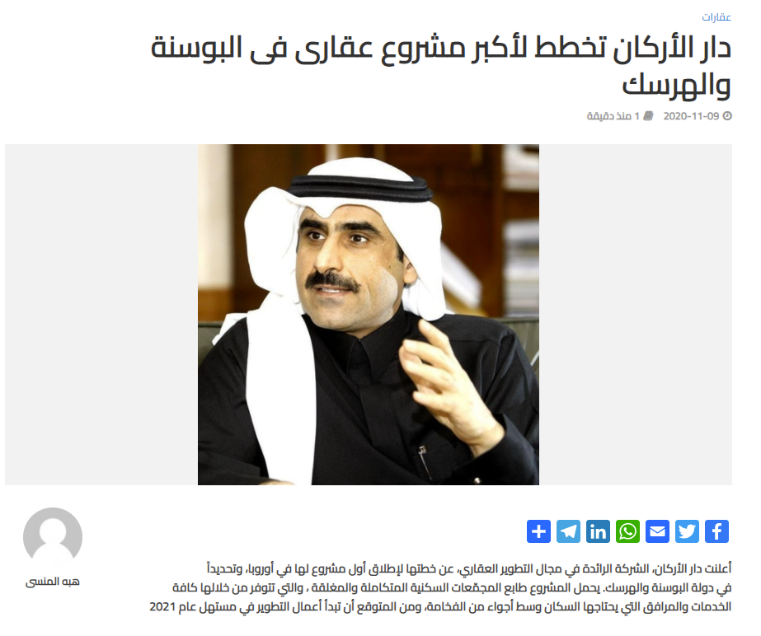
Nov 2020: Dar Al Arkan plans first residential project in Bosnia and Herzegovina
Argaam
Amwal

Slide 9
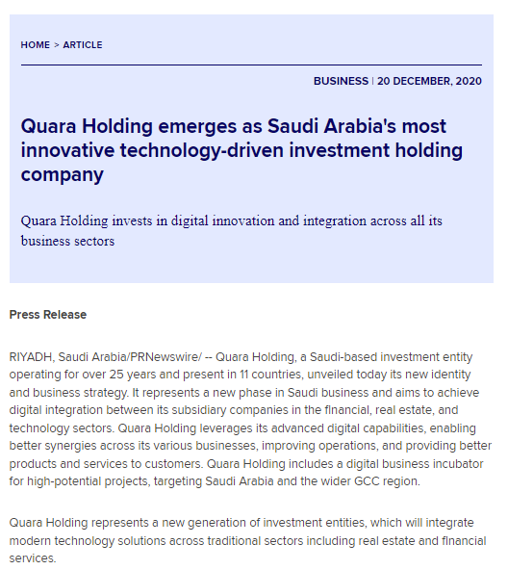
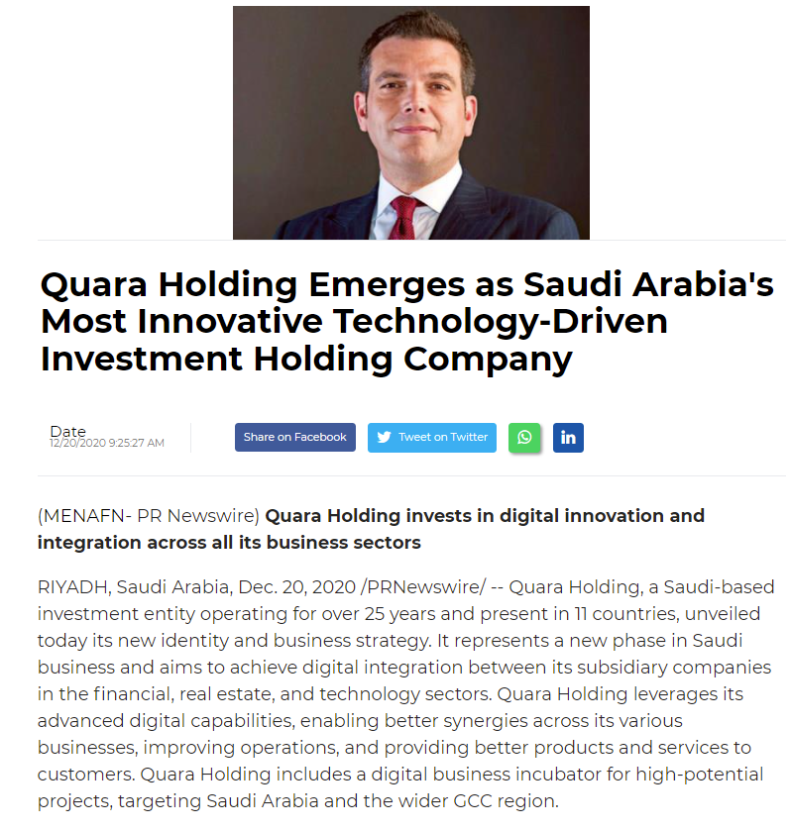
Dec 2020: Quara Holding emerges as Saudi Arabia's most innovative technology-driven investment holding company
Zawya
MENAFN

Slide 10
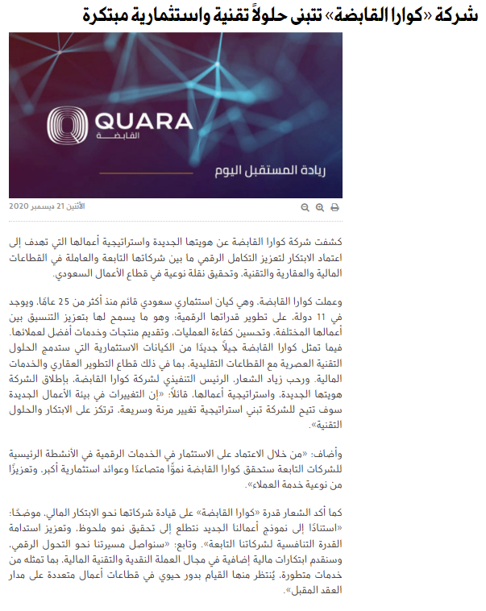
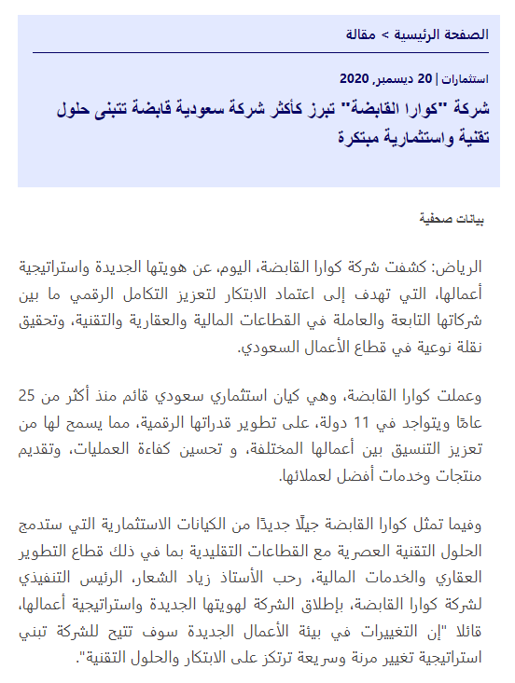
Dec 2020: Quara Holding emerges as Saudi Arabia's most innovative technology-driven investment holding company
Al Jazirah
Zawya

Slide 11
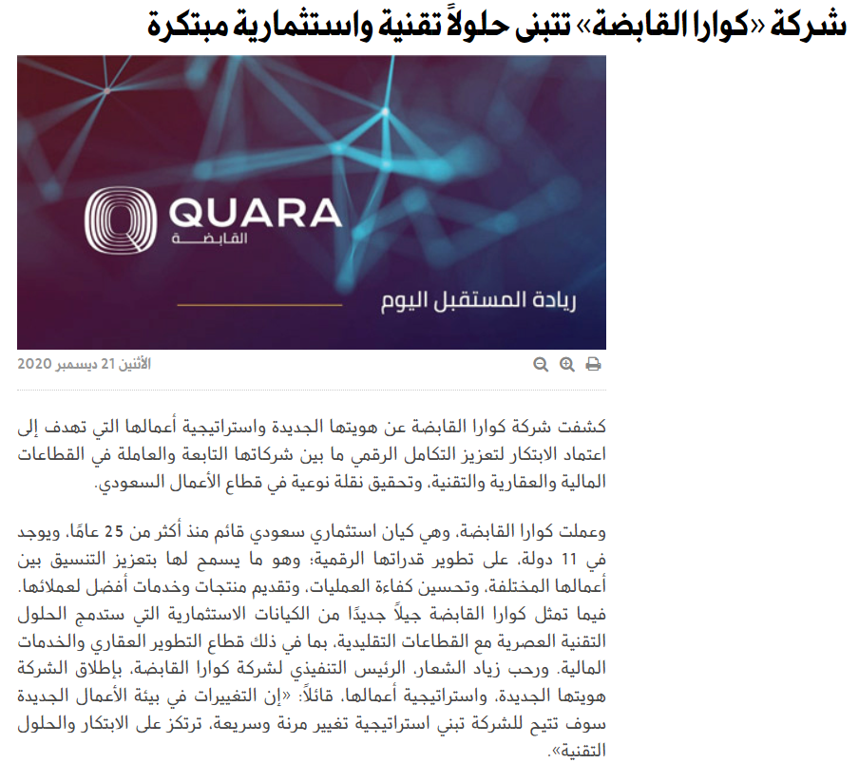
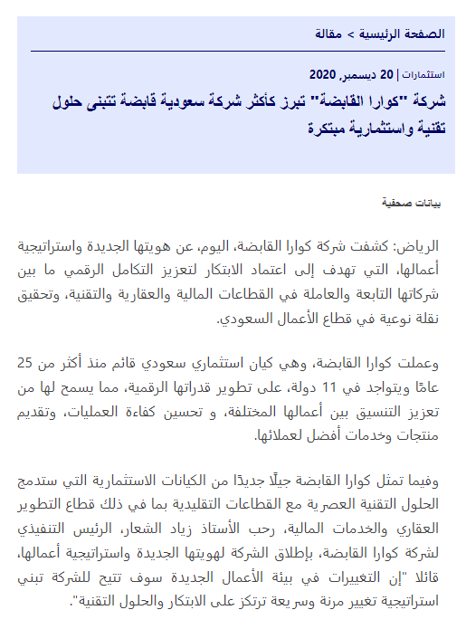
Dec 2020: Quara Holding adopts innovative technology and investment solutions
Al Jazirah
Zawya

Slide 12
2021
Coverage Highlights

Slide 13
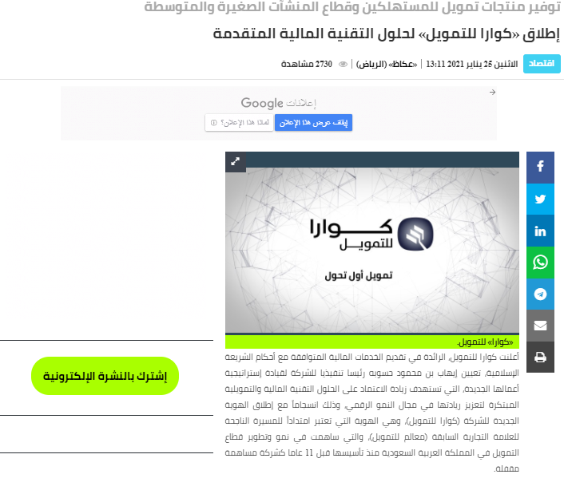
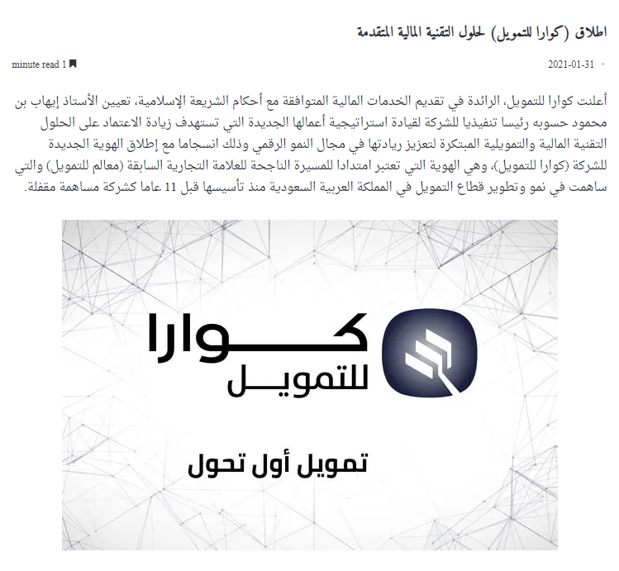
Jan 2021: Launching (Quara Finance) for advanced financial technology solutions
Okaz
Riyadh Key

Slide 14
Jan 2021: Launching (Quara Finance) for advanced financial technology solutions
Okaz
Riyadh Key

Slide 15
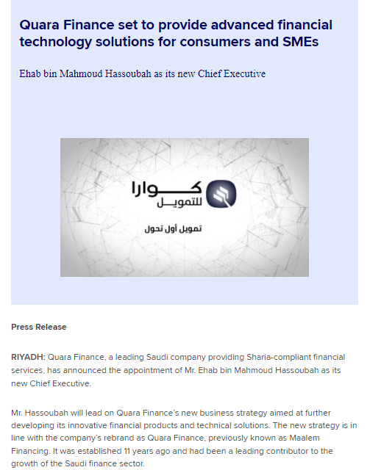

Jan 2021: Quara Finance set to provide advanced financial technology solutions for consumers and SMEs
Zawya
Mubasher

Slide 16
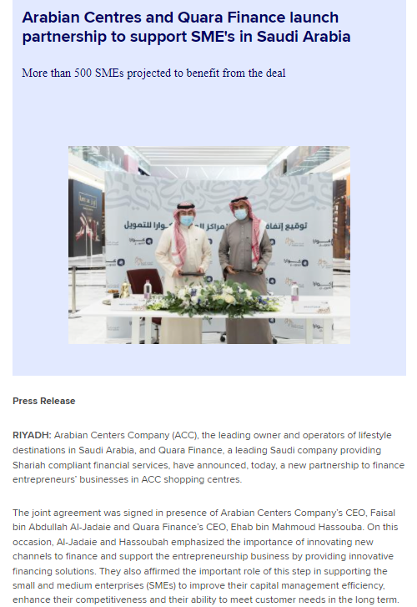
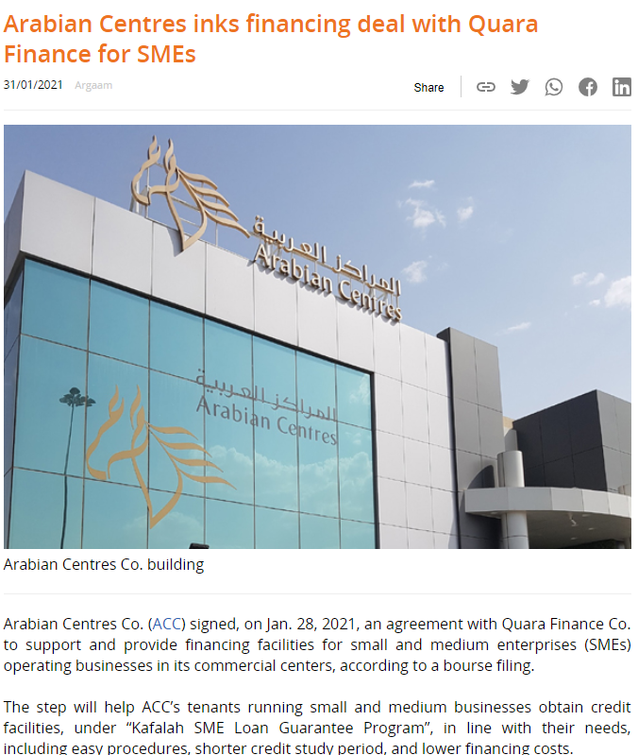
Jan 2021: Arabian Centres and Quara Finance launch partnership to support SME's in Saudi Arabia
Zawya
Argaam

Slide 17
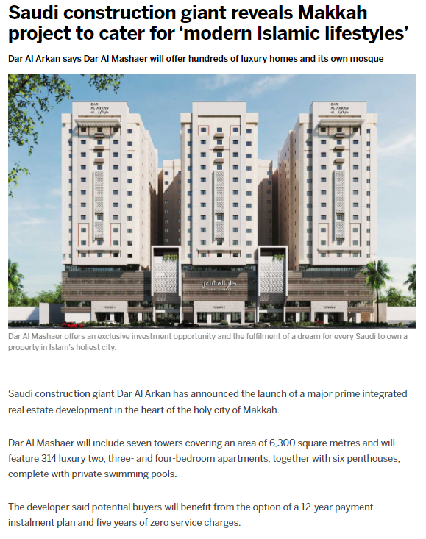
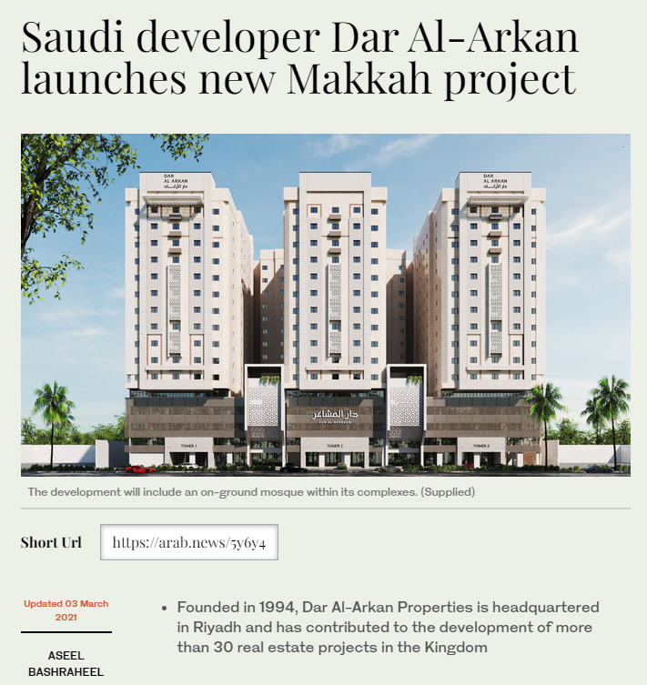
March 2021: A new prime real estate development in Mecca is launched by Dar Al Arkan
Arabian Business
Arab News

Slide 18
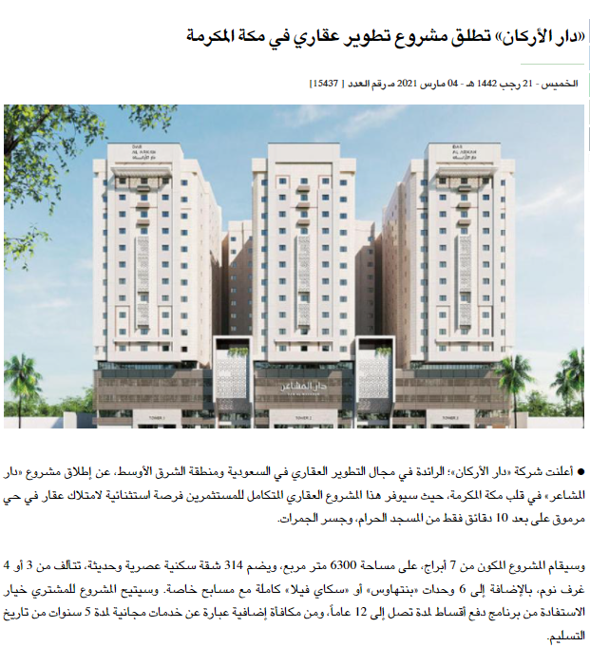
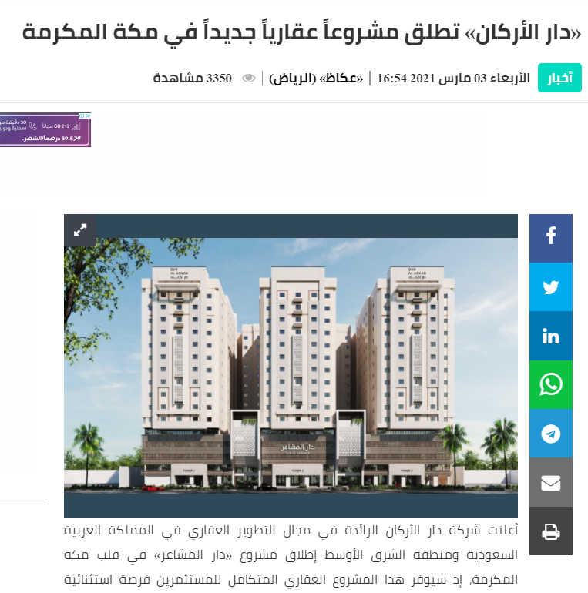
March 2021: A new prime real estate development in Mecca is launched by Dar Al Arkan
Aawsat
Okaz

Slide 19
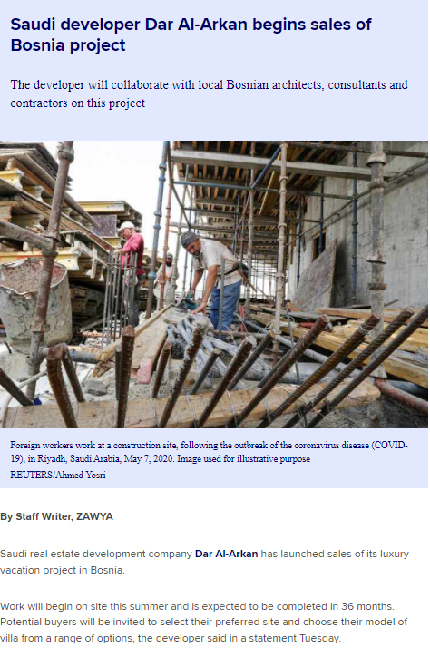
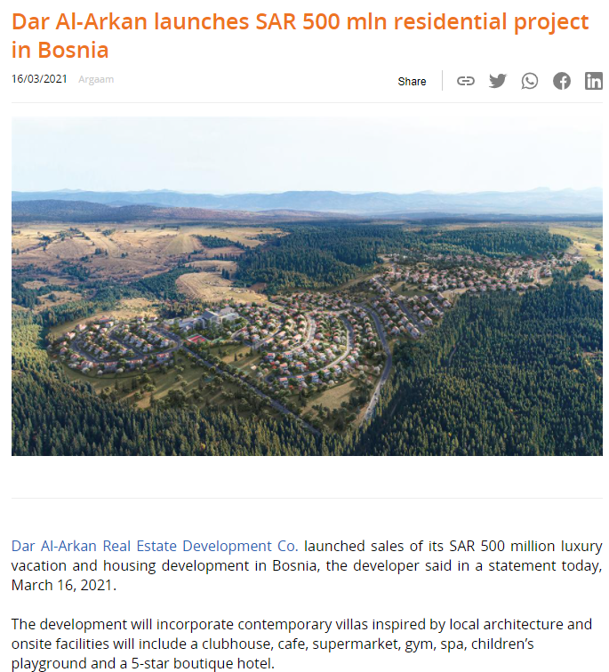
March 2021: Dar Al Arkan moves actively to spread Saudi Arabian brands overseas and start works on Sidra, the first of its kind vacation and 2nd homes project in Bosnia
Zawya
Argaam

Slide 20
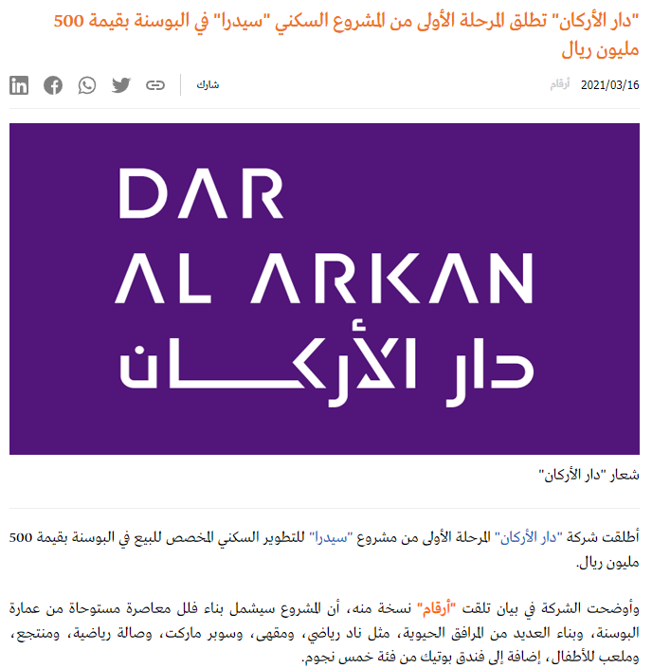
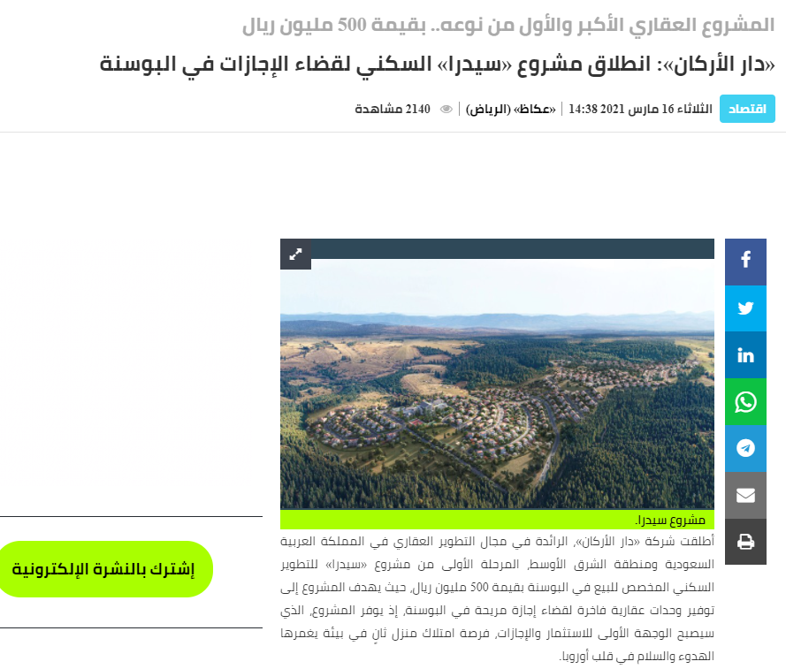
March 2021: Dar Al Arkan moves actively to spread Saudi Arabian brands overseas and start works on Sidra, the first of its kind vacation and 2nd homes project in Bosnia
Argaam
Okaz

Slide 21
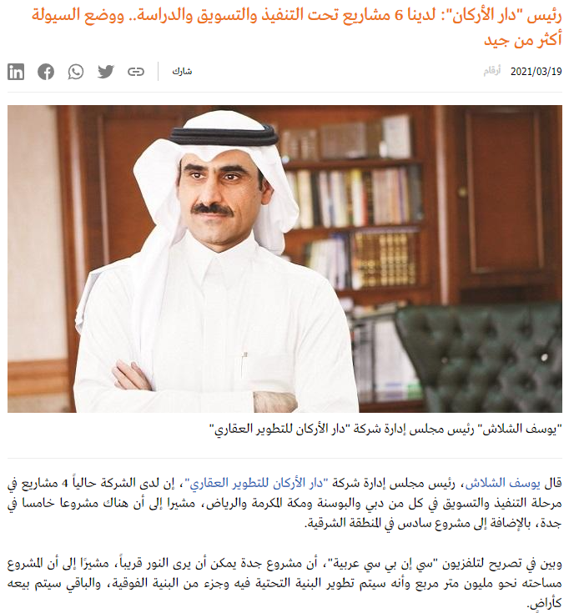
March 2021: Chairman of Dar Al Arkan: We have 6 projects under implementation, marketing and study... and the liquidity situation is more than good
Argaam

Slide 22
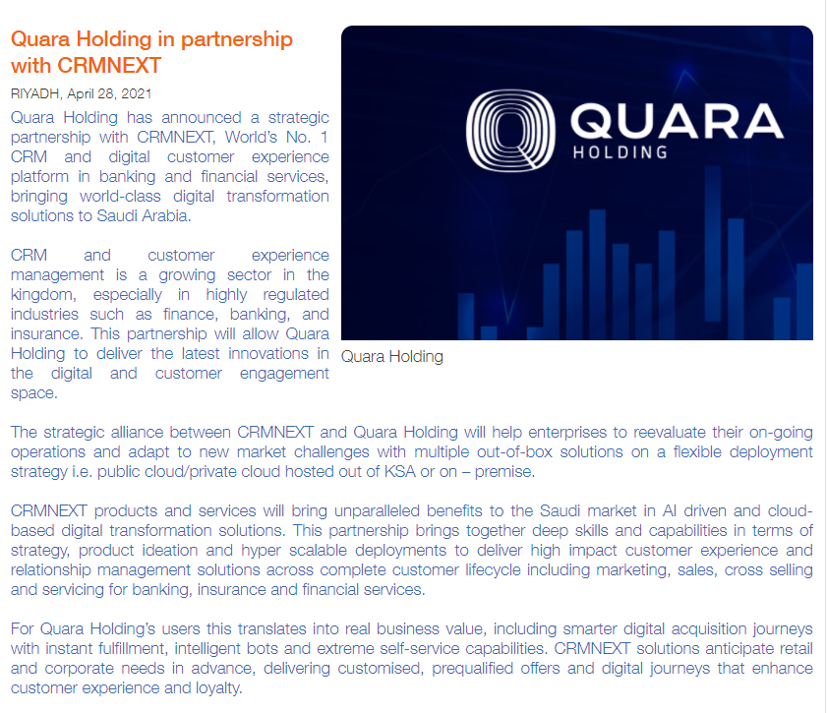
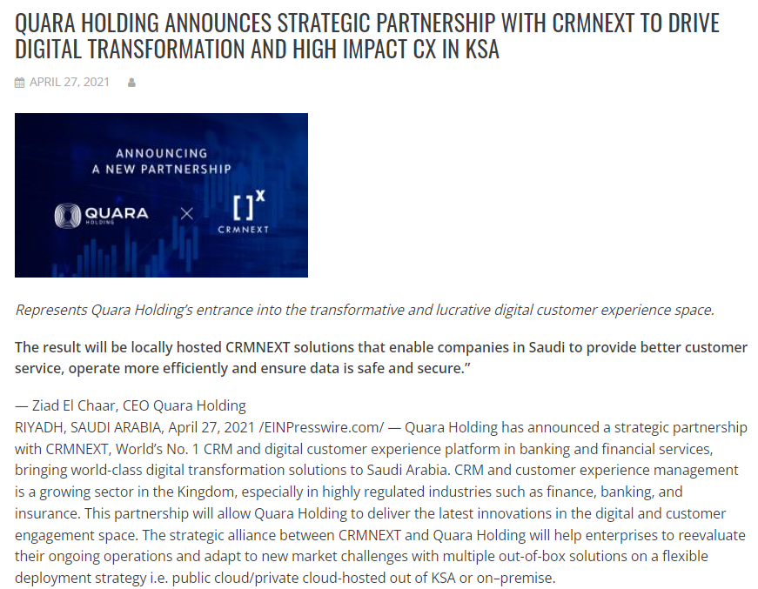
April 2021: Quara holding announces strategic partnership with CRMNEXT to drive digital transformation and deliver high impact customer experience solutions in KSA
Trade Arabia
TechToday

Slide 23
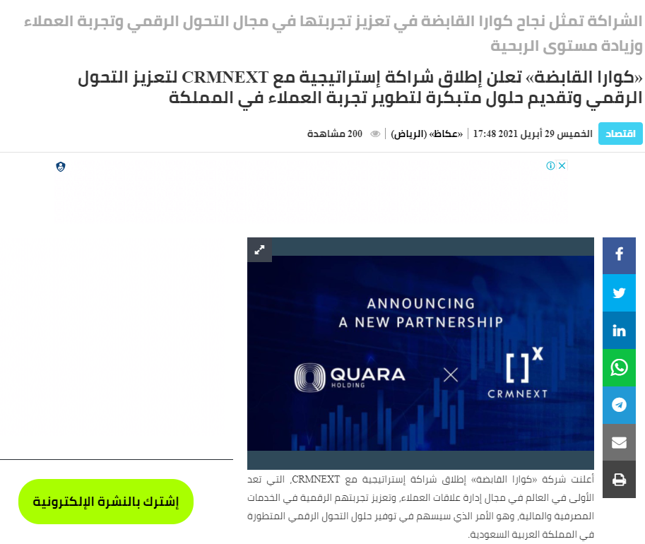

April 2021: Quara holding announces strategic partnership with CRMNEXT to drive digital transformation and deliver high impact customer experience solutions in KSA
Okaz
Saudiict

Slide 24
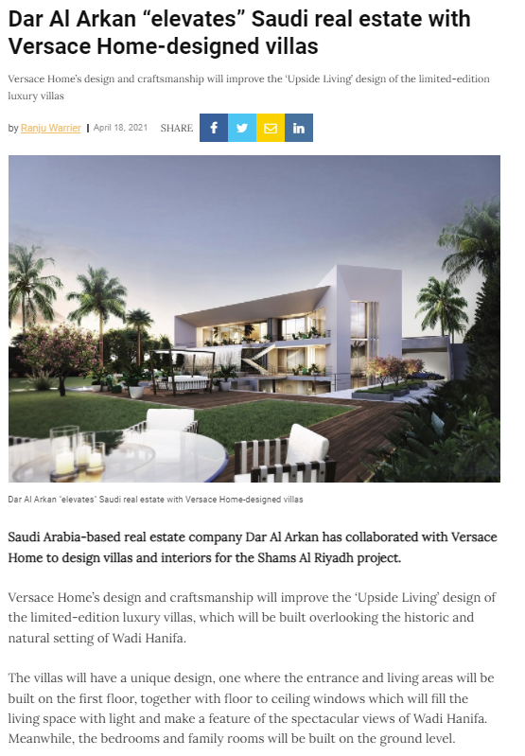
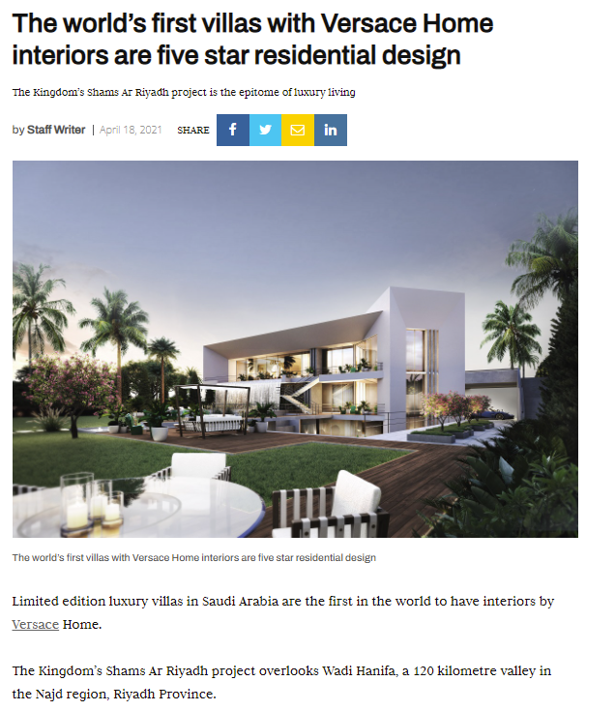
April 2021: Dar Al Arkan brings world’s first villas with Versace Home interiors at Shams Ar Riyadh
Construction Week
Commercial Interior Design

Slide 25
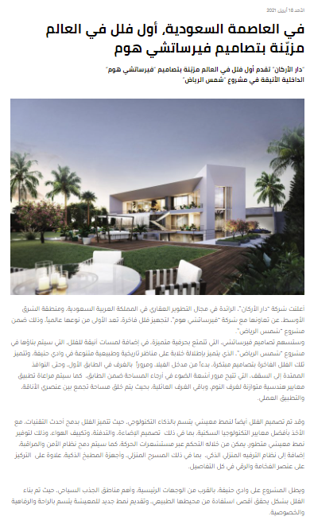
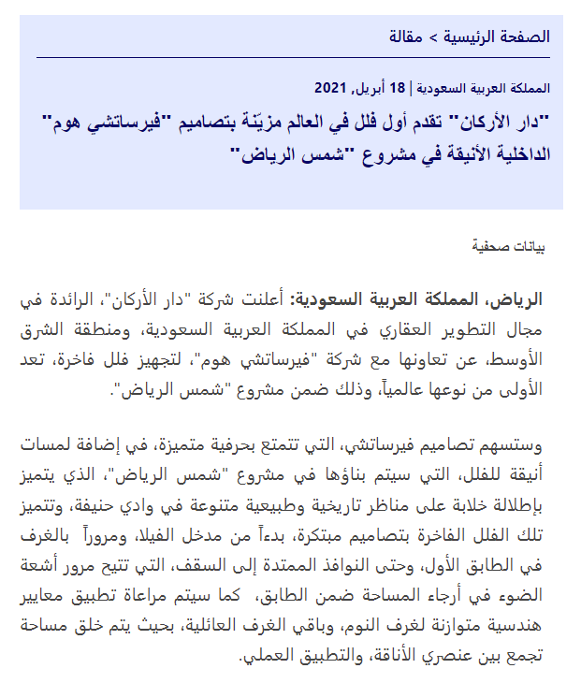
April 2021: Dar Al Arkan brings world’s first villas with Versace Home interiors at Shams Ar Riyadh
Arabian Business
Zawya

Slide 26
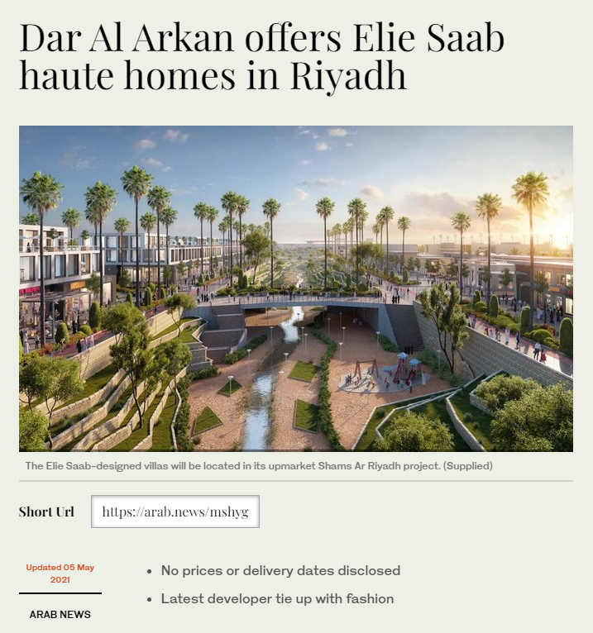
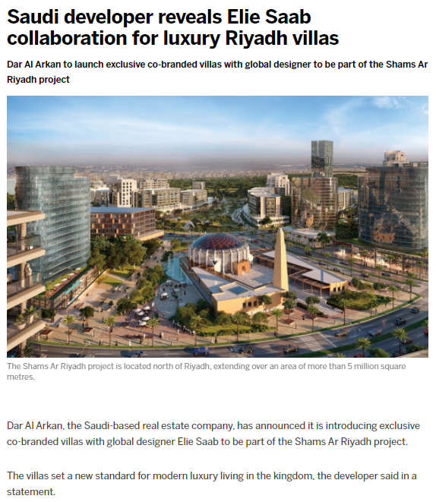
May 2021: Dar Al Arkan reveals exclusive villas in Shams Ar Riyadh designed by ELIE SAAB setting new standards for premium living
Arab News
Arabian Business

Slide 27
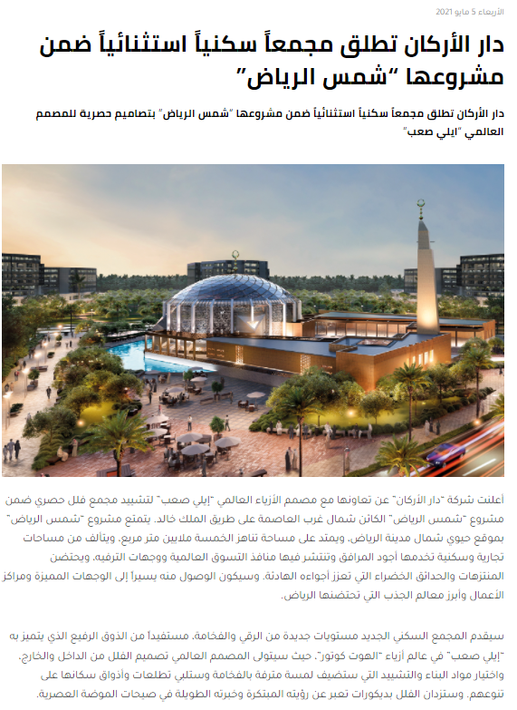
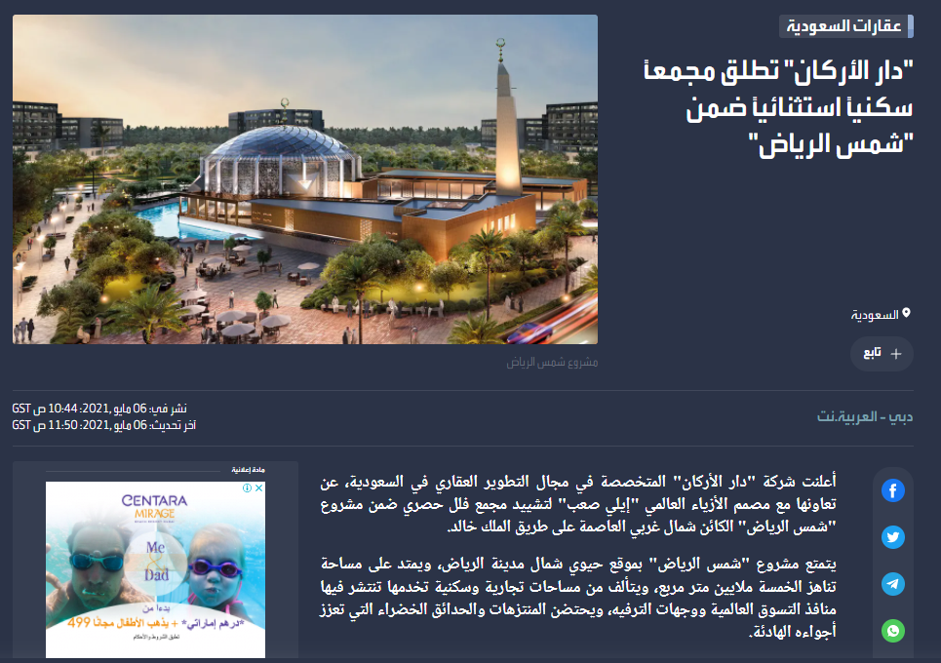
May 2021: Dar Al Arkan reveals exclusive villas in Shams Ar Riyadh designed by ELIE SAAB setting new standards for premium living
Arabian Business
Al Arabiya

Slide 28

June 2021: Quara Holding partners with blockchain technology leader, ConsenSys
Arab News
Zawya

Slide 29
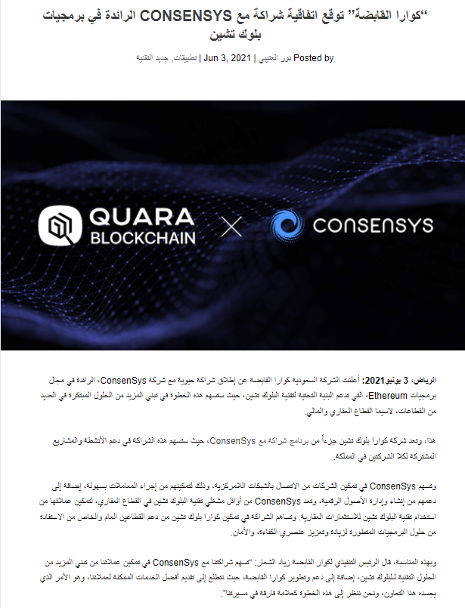
June 2021: Quara Holding partners with blockchain technology leader, ConsenSys
Arriyadiyah
Saudiict

Slide 30
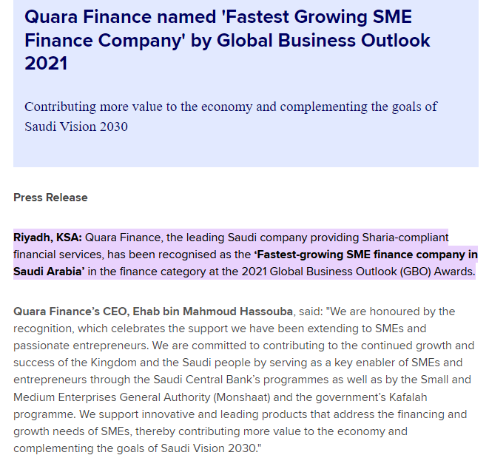
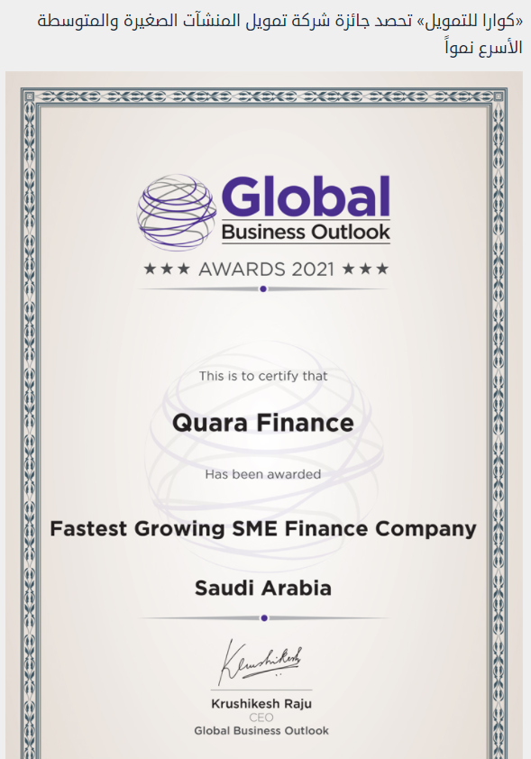
June 2021: Quara Finance named 'Fastest Growing SME Finance Company' by Global Business Outlook 2021
Zawya
Carnews 2day

Slide 31
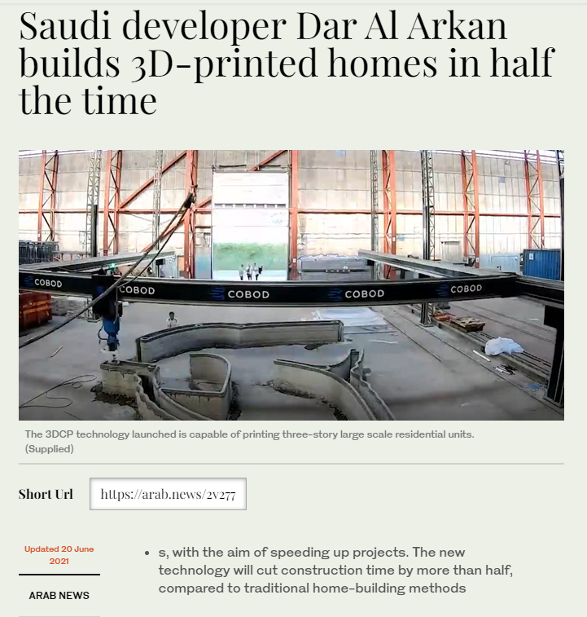
June 2021: Dar Al Arkan marks regional first with 3D Construction Printing technology for high-speed, quality construction
The National
Arab News

Slide 32
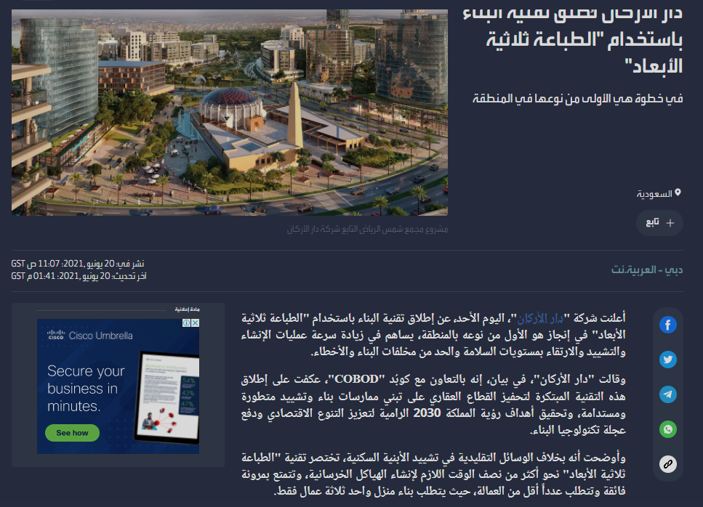
June 2021: Dar Al Arkan marks regional first with 3D Construction Printing technology for high-speed, quality construction
Arabian Business
Al Arabiya

Slide 33
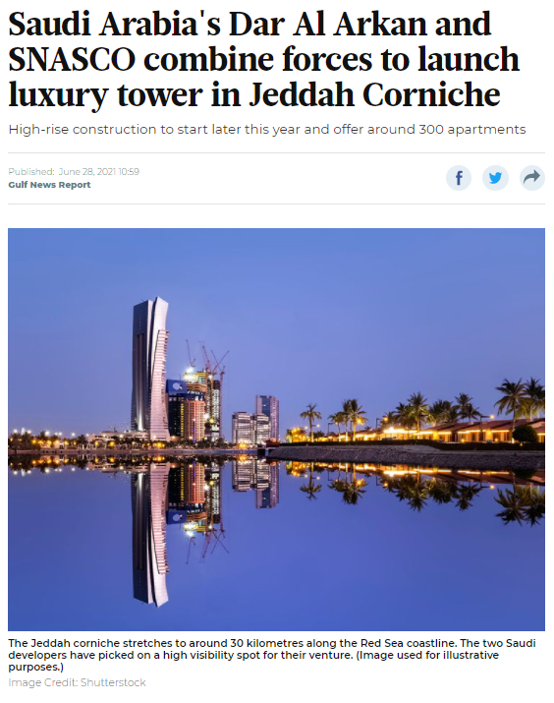
June 2021: Dar Al Arkan and SNASCO Real Estate launch joint venture to develop luxury real estate tower on Jeddah Corniche
Arab News
Gulf News

Slide 34
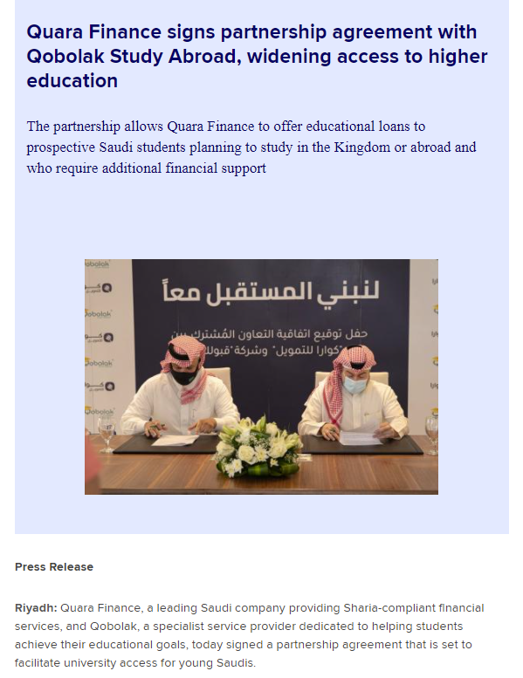
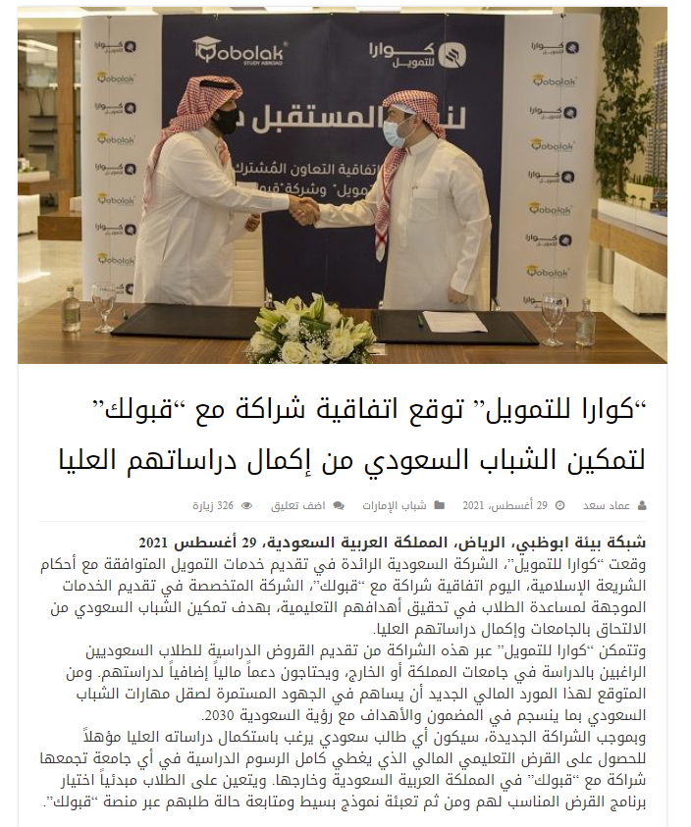
Aug 2021: Quara Finance signs partnership agreement with Qobolak Study Abroad, widening access to higher education
Zawya
Abu Dhabi Env

Slide 35
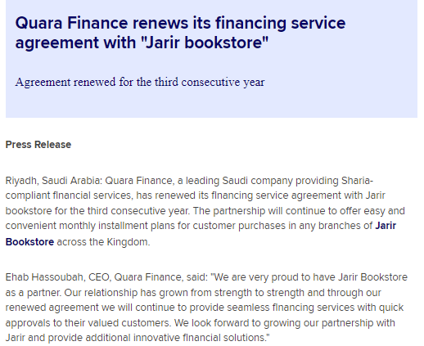

Sept 2021: Quara Finance Renews its Financing Service Agreement with ‘Jarir Bookstore’
Zawya
Riyadh Key

Slide 36


Sept 2021: Quara Finance signs an agreement with Creative Future for Digital Brokerage to be part of ‘Tanwil’ portal
Aleqt
Mubasher

Slide 37


Sept 2021: Quara Finance receives two prestigious awards from World Business Outlook Awards 2021
ME News
Rowad Al Aamal

Slide 38

Oct 2021: Quara Finance signs strategic agreements with three leading medical centers in Saudi Arabia
Arriyadiyah
Eat’N Stays

Slide 39
Oct 2021: Dar Al Arkan teams with Missoni to deliver the exclusive Urban Oasis water-front residential tower in Dubai
Gulf News
The National

Slide 40

Oct 2021: Dar Al Arkan teams with Missoni to deliver the exclusive Urban Oasis water-front residential tower in Dubai
Al Khaleej
Al Watan

Slide 41


Oct 2021: Dar Al Arkan and Qetaifan Projects partner to develop premium sea-front project on Qetaifan Island North
Gulf Business
MEED

Slide 42


Oct 2021: Dar Al Arkan and Qetaifan Projects partner to develop premium sea-front project on Qetaifan Island North
Arriyadiyah
Al Riyadh

Slide 43


Oct 2021: Dar Al Arkan and Madinat Al Wouroud join forces for a premium eco-friendly residential project nestled within Taif’s breath-taking nature
Arab News
Saudi Gulf Projects

Slide 44


Oct 2021: Dar Al Arkan and Madinat Al Wouroud join forces for a premium eco-friendly residential project nestled within Taif’s breath-taking nature
Argaam
Saudiict

Slide 45


Oct 2021: Quara Finance continues to expand its focus on the education sector by partnering with new certified educational providers
Zawya
Saudiict

Slide 46
Oct 2021: Dar Al Arkan brings world’s first villas with Versace Home interiors at Shams Ar Riyadh
Design Middle East

Slide 47
Nov 2021: Designing luxury experience
Construction Business News

Slide 48


Dec 2021: Dar Al Arkan Announces Strategic Partnership with Compass Project Consulting
Construction Week Online
Saudi Projects

Slide 49
Dec 2021: Dar Al Arkan Announces Strategic Partnership with Compass Project Consulting
Arriyadiyah
Al Bilad

Slide 50
Dec 2021: Dar Al Arkan teams with Pagani Automobili to unveil the ultra-exclusive DaVinci Residential Tower in Dubai
Gulf News
The National

Slide 51

Dec 2021: Dar Al Arkan teams with Pagani Automobili to unveil the ultra-exclusive DaVinci Residential Tower in Dubai
Al Khaleej
CNBC Arabia

Slide 52


Dec 2021: Dar Al Arkan teams with Pagani Automobili to unveil the ultra-exclusive DaVinci Residential Tower in Dubai
Dubai TV
Al Arabiya

Slide 53
By numbers: May – Dec 2021
Hits: 2,138
Reach/Online Impressions: Over 303M
Earned Media Value: $44.6M

Slide 54
Quara Holding
Coverage Highlights
2020 - 2021
December 2021

